Slide 1
Authentication Using Encrypted Negative Password
Team Details
K SAI VAMSHI(20EG105356)
L NEHA REDDY(20EG105358)
K ANISH CHANDRA(20EG105355)
Project Supervisor
Dr. T Shyam Prasad
M.Tech(CSE), Ph.D
Assistant Professor,CSE
Anurag University

Slide 2
Introduction
Secure password storage and authentication schemes are the backbone of the Internet. Any website which has user accounts should store its users’ data as securely as possible, since any passwords which are broken can be used to log into users’ accounts on other websites due to the commonality of password reuse. In addition, due to users choosing insecure passwords, simply hashing the given password is often not enough to prevent passwords from being discovered if an internal data table is stolen. Due to the importance of this problem, there have been several schemes which have been both proposed and used over the years. There are various authentication schemes available but each one has its own share of advantages as well as disadvantages.
So, there is a need for a robust system to secure passwords to ensure both usability and security.
The applications of Encrypted Negative Passwords are : Corporate Security Systems, E-Commerce and Banking Platforms , Social Media, Cloud Service Providers, etc.

Slide 3
Problem Statement
Traditional password-based authentication systems face persistent challenges such as password leaks, brute-force attacks, and the vulnerabilities associated with weak or reused passwords.
Text-based passwords are still the most widely used authentication technique, despite its some security flaws. As organizations strive to enhance the security of their systems, there is a pressing need for innovative authentication mechanisms that can resist evolving threats.
To address these issues, there is a need for innovative authentication methods that enhance security while also maintain usability.

Slide 4
Proposed Method
ENCRYPTED NEGATIVE PASSWORD:
The proposed framework includes two phases: the registration phase and verification phase.
When adopting our framework to protect passwords in an authentication data table, the system designer must first select a cryptographic hash function and a symmetric-key algorithm, where the condition that must be satisfied is that the size of the hash value of the selected cryptographic hash function is equal to the key size of the selected symmetric-key algorithm.
The ENP is the first password protection scheme that combines the cryptographic hash function, the negative password and the symmetric-key algorithm, without the need for additional information except the plain password ensuring robust security and usability.

Slide 5
Proposed Method
Illustration :
For Example, a user wants to access a particular website and the process is divided into 2 phases:
The registration phase of ENP has three main steps, as follows.
1. Hash the password
2. Convert to a negative password
3. Encrypt the negative password with hashed password as key:
Enc(H(pass), NP)
Given a username and password, the process of verifying the password consists of the following four steps.
1. Retrieve the ENP corresponding to the given username
2. Hash the password
3. Decrypt the ENP to get a negative password- Dec(H(pass), ENP).
4. Check that the hashed password is the solution to the negative password

Slide 6
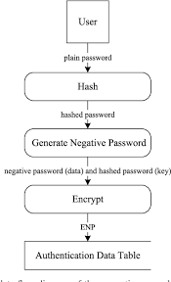
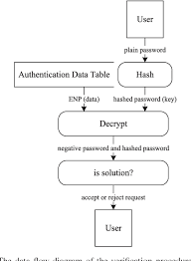
Proposed Method

Slide 7
Experiment Environment
Hardware Requirements : Intel Core i3 or more,
RAM Capacity : 4GB or more
Frontend framework : Django, html, css
Programming language : Python
Database : MySQL
IDE : Visual Studio Code

Slide 8


Experiment Screen shorts

Slide 9
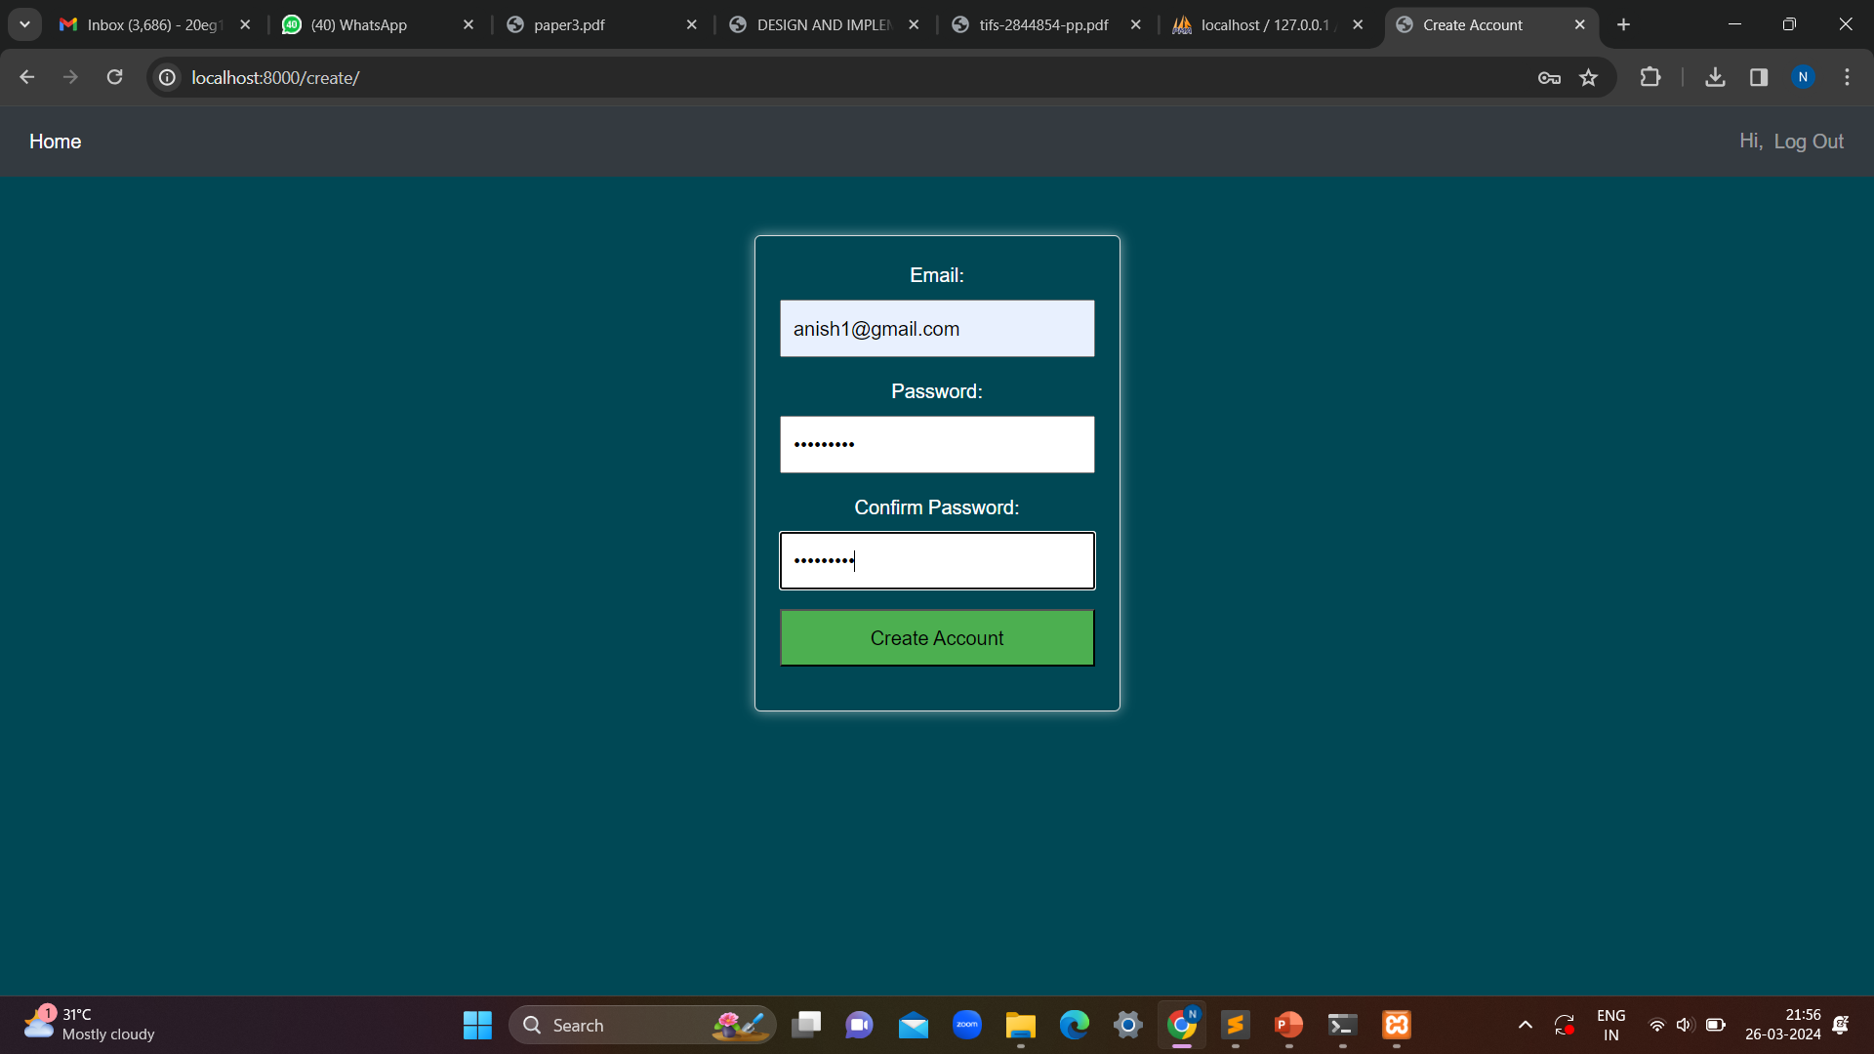
Experiment Results

Slide 10

Experiment Results

Slide 11

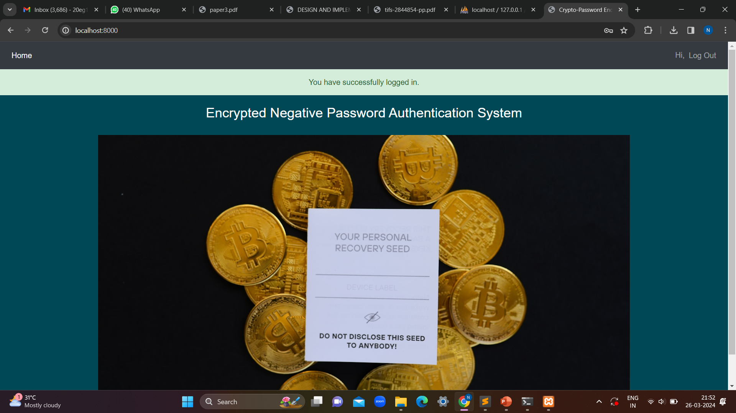
Experiment Results

Slide 12
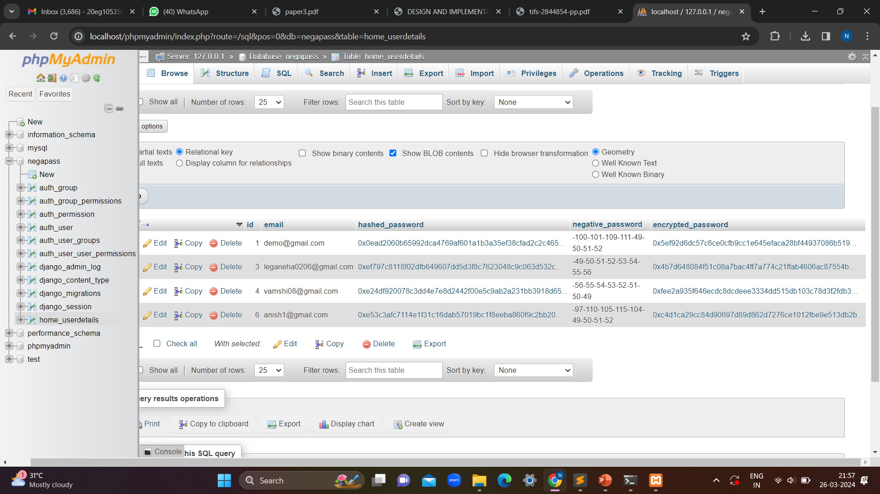
Experiment Results

Slide 13
Finding
In this project, we proposed a password protection scheme called ENP, and presented a password authentication framework based on the ENP.
The results show that the ENPprovide stronger password protection under dictionary attack.
Users also found this method convenient compared to other authentication methods since it maintains security as well as usability without causing additional trouble to the user.
It also provides 3 layers of security to the password by combining hashing, negative password algorithm and encryption algorithm.

Slide 14
Justification
Parameter | Previous methods | Proposed method
Hashing Formula | Specific hashing algorithms used for password protection. | Incorporates a cryptographic hash function for password hashing.
Encryption Formula | May or may not involve encryption for added security. | Introduces symmetric-key encryption as part of the protection scheme.
Negative Authentication Criteria | Traditional methods may lack negative authentication criteria. | Integrates negative authentication criteria into the protection process.
Monitoring Criteria | Monitoring may not be a built-in feature of previous methods. | Incorporates monitoring criteria for detecting suspicious activities.
Key Management | Key management practices may vary based on the method. | Requires selecting a symmetric-key algorithm and ensuring the key size matches the hash value size.
Number of ENP Generated | Number of encrypted negative passwords may not be a consideration. | Specifies the generation and management of ENPs for additional security.
Performances of ENP | Performance may vary based on hashing and encryption complexities. | Ensures optimized performance while combining hashing, encryption, and negative authentication.

